Slide 1
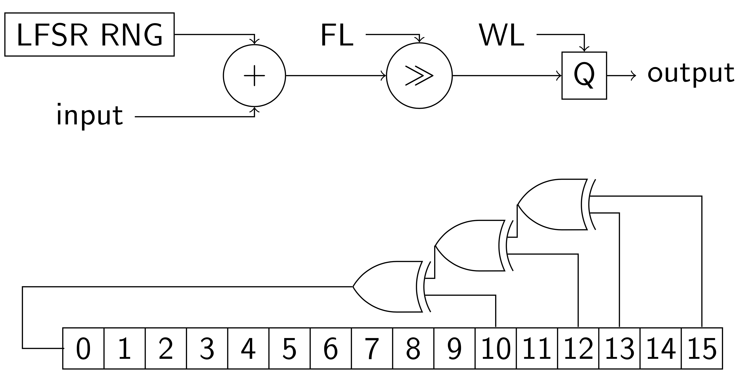
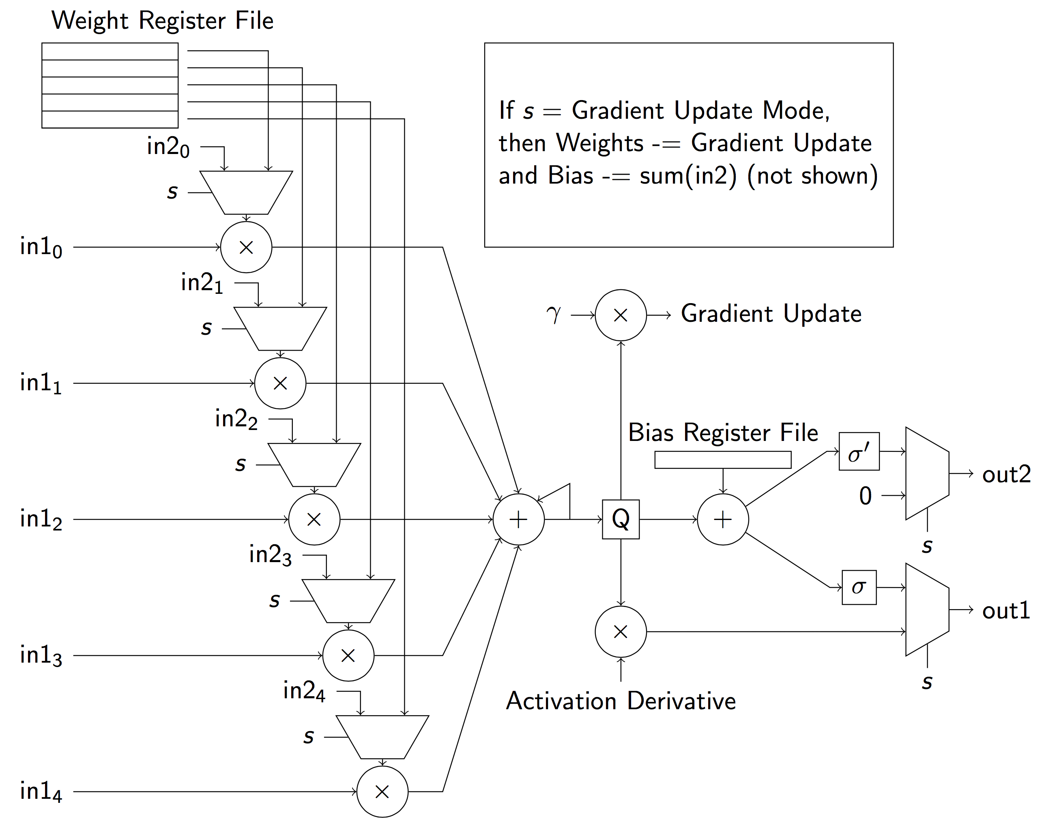
Training Convolutional Neural Networks on FPGAs
Kyle Daruwalla (daruwalla@wisc.edu) and Akhil Sundararajan (asudararaja@wisc.edu)
Introduction and Motivation
Hardware Design
Results
CNNs are popular for image classification, speech recognition, and object recognition
CNN training phase is limited by general purpose hardware
Memory access latency
Complex arithmetic units
Field-programmable gate arrays (FPGAs) are a platform for designing specialized hardware
Apply traditional hardware design techniques to the CNN training algorithm
All numbers are represented in 16-bit fixed point
1 sign bit, 1 integer bit, 14 fractional bits
Stochastic rounding is used for quantization
Convolution layers are condensed into a series of parallel ”filter units”
Each unit is capable of performing feed-forward pass and backpropagation
Units keep local register files with weights and biases
Limited Precision Convergence
Goals and Objectives
Insert figure
Train a CNN using TensorFlow on various Amazon EC2 Spot Instances
Design and validate limited precision CNN training hardware for FPGAs
Simulate limited precision CNN algorithm in MATLAB
Measure and compare accuracy and training time for equivalent number of gradient computations
Design Specifications
Conclusions and Future Work
CNN Structure: CONV -< POOL -< FC
Software baseline implemented in TensorFlow
Run on Amazon EC2 c2x.large
Run on Amazon EC2 c8x.large
MATLAB simulation custom built for limited precision
FPGA design targeting Xilinx Artix-7 Series
CNNs do not fit on current FPGAs (memory constrained)
Hardware controller does not scale well as CNN grows
Need CNNs with smaller weight kernels
Bulk of future work is in partitioning and communicating between FPGAs
Use quantization noise intelligently to make CNN robust

